Slide 1

Methodist College of Engineering and Technology
Department of Computer Science Engineering
Prediction of Remaining Useful Life of Li-ion Battery
Project Team:
S.No. | Roll no. | Student Name | Role in Team
1 | 160720733016 | Adupala Ankitha | Team Lead
2 | 160720733048 | P. Aditya Vishwa Teja | Team Member
3 | 160720733005 | P. Khaja Muneer | Team Member
Under the Guidance of: Dr. M. Sharada Varalakshmi
Professor & Head
Department of AI&DS
Project Coordinator:
Dr T. Praveen Kumar
Associate Professor
Department of CSE

Slide 2
Contents
Introduction
Literature Survey
Motivation
Problem Statement
Objectives
Proposed Architecture
System Design
Code Implementation
Results

Slide 3
Introduction
The scope of Electric Vehicles in the future is gradually increasing. As environmental concerns, technological advancements EVs are set to become the mainstream mode of transportation.
EV vehicles working is based on Batteries.
Even we have advantages of using EV Vehicles, they are also are getting exploded due to environmental concerns and low maintenance.
We can reduce electric vehicle explosion by introducing a strong and smart BMS(Battery Management System) which predicts the Remaining Useful Life(RUL) of a Battery.

Slide 4
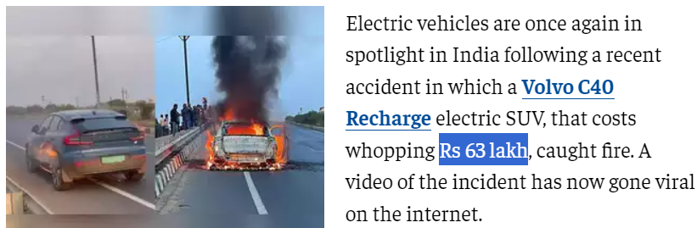

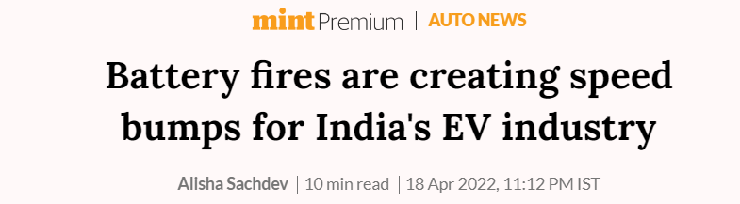



Articles

Slide 5
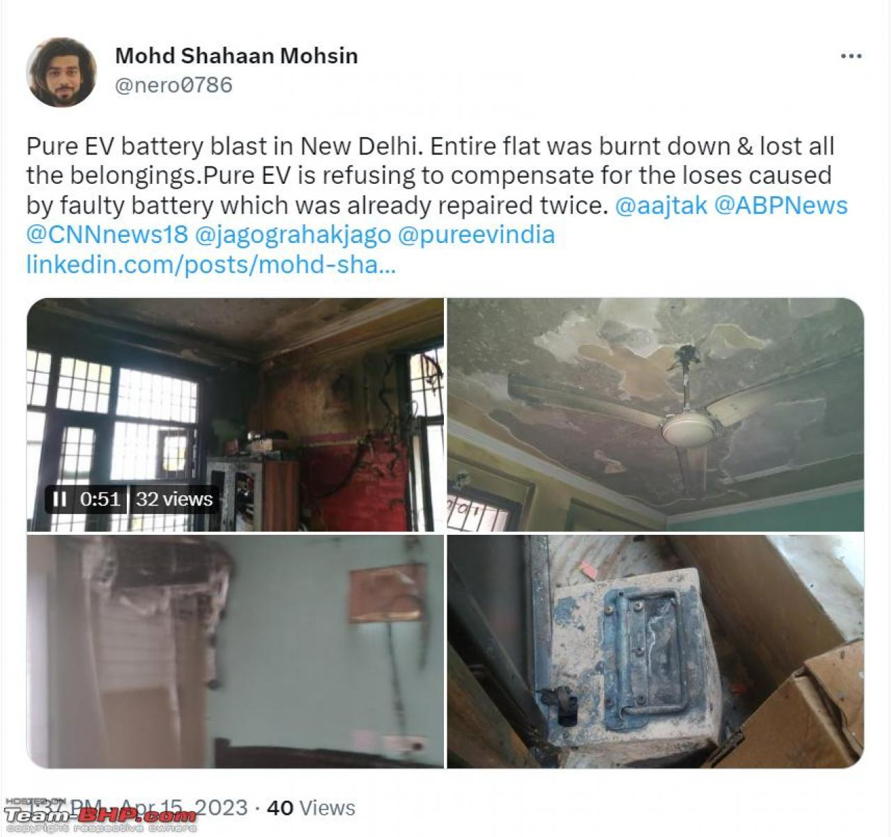
How can we build trust?
Nobody is going to buy a product that can catch fire. Although large corporations can afford to take such a hit on their brand value with incidents like these, startups cannot.
We need to introduce new technologies in order to avoid explosion of EV’s
OEMs in India are struggling to optimize the cost and the efficiency. "The incorporation of such high-end BMS and thermal management systems increases the cost of the vehicle and increases the existing gap between the EVs and the ICE vehicles.

Slide 6
BATTERY
Battery is a combination of electrodes and electrolytes.
Electrodes are nothing but anode and cathode.
CHARGING PROCESS:
Electrons move from Cathode to Anode.
DISCHARGING PROCESS:
Electrons move from anode to Cathode.
Reason for Degradation of Battery:
During charging and Discharging process that is moving electrons from cathode to anode and vice versa there forms a layer called SEI(Solid electrolyte Interface)
Due to increase in SEI layer the performance of a battery gradually decreases.

Slide 7
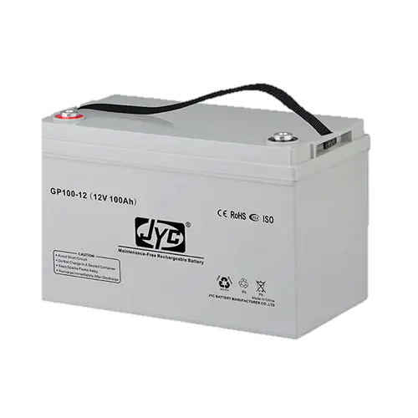

Types of Battery
Dry Battery A dry battery, also known as a primary cell, is a type of battery that uses an electrolyte in the form of a paste or gel. The electrolyte is immobilized, meaning it doesn't flow freely like in wet batteries. | 2. Wet battery A wet battery, also known as a secondary cell or rechargeable battery, is a type of battery that uses a liquid electrolyte, typically sulfuric acid.
Fig 1: Dry Battery
Fig 2: Wet Battery

Slide 8
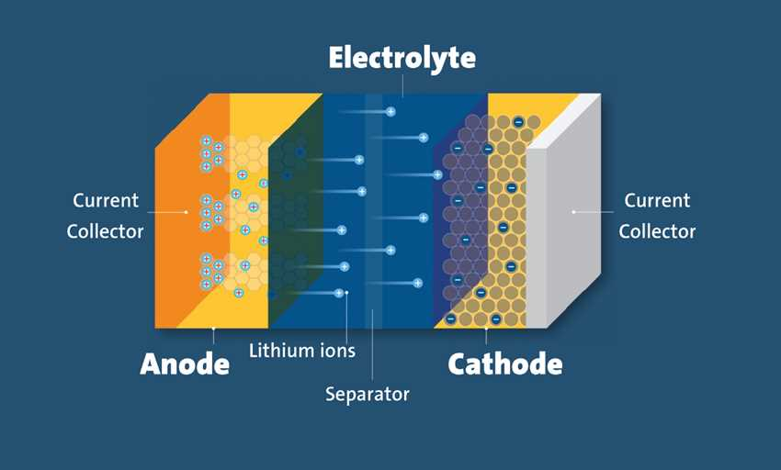
Li-ion Battery
Lithium-ion (Li-ion) batteries are typically considered "dry" batteries because they use a solid or gel-like electrolyte rather than a liquid electrolyte.
Advantages:
High Energy Density
Long Cycle Life
Low Self-Discharge Rate
Fast Charging
No Memory Effect
Disadvantages:
Safety Concerns
High Cost
Limited Lifespan
Environmental Concerns
Electric vehicles (EVs) use lithium-ion batteries due to their high energy density, which enables longer driving ranges on a single charge compared to other battery technologies.
Fig 3: Li-ion battery

Slide 9
Battery management system
High-end EV products are currently used by Tesla, Audi, and BMW, along with a liquid cooling system to reduce the temperatures of the battery pack.
In India it is impossible to use liquid cooling system in EV as it is expensive and increases cost of vehicle.
Battery Management System is an alternative and cost effective to develop safety concerns.
This can reduce disruptions and explosions of Electric Vehicle.
The battery management system is key to the safe and reliable operation of a Li-ion battery pack.

Slide 10
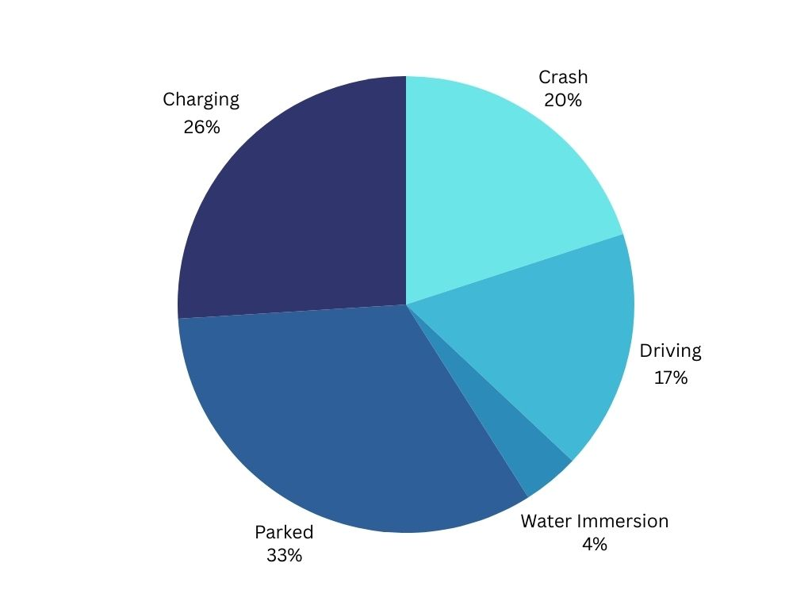
Cause of disruption on EV’s
The causes of Disruption on EV Vehicle are mainly due to: 1. Parked Vehicle 2. Charging 3. Crash 4. Driving 5. Water Immersion
Fig 4: Disruption of EV’S

Slide 11
Reasons for Battery Ageing
Battery ageing can be dissociated into two parts:
1)Calendar Ageing
2)Cycle Ageing
Calendar Ageing:
It is a Natural Degradation Process(Cathode and anode degradation) in Lithium ion batteries that occurs over time irrespective of usage .Factors such as temperature, state of charge, storage conditions influence this aging.
Cycle Ageing:
The Impacts of Battery utilization periods named cycles that means charge and discharge cycles influences cycle Ageing

Slide 12
Literature survey

Slide 13
Sno | Title of the Paper | Author | Year | Description | Drawback
1 | Empirical Modeling of Capacity Fade in Li-ion Batteries(2005) | John Smith, Emily Johnson | 2005 | Proposed a predictive model for remaining capacity based on cycling data | limited applicability to different battery chemistries and cycling conditions, potentially leading to inaccuracies in predicting capacity fade.
2 | Predicting Remaining Useful Life Using Neural Networks | Wei Wang, Ling Zhang | 2008 | Developed a predictive model using electrochemical impedance spectroscopy and neural networks | It limits its practical applicability and scalability in real-world settings. Additionally, the model's accuracy may be impacted by the need for extensive training data and the potential for overfitting to specific experimental conditions.
3 | Data-driven Techniques for RUL Prediction | Saxena | 2008 | Introduced a particle filtering approach leveraging historical Li-ion battery datasets | Performance may degrade with insufficient or noisy data; Limited by the quality and quantity of available data

Slide 14
Sno | Title of the paper | Author | Year | Description | Drawback
4 | Prognostics and Health Management of Electronics | Saha, Bhaskar; Pecht, Michael | 2011 | Provides an overview of prognostics and health management techniques, applicable to lithium-ion batteries. | Focuses on electronics but offers insights into general prognostics principles.
5 | Physics-based Modeling and Simulation of Lithium-ion Batteries | Ramadesigan, V.; Northrop, Paul W.C.; De, Sumi | 2012 | Presents physics-based modeling and simulation techniques for understanding battery behavior and predicting RUL. | Complex mathematical formulations may limit accessibility.
6 | A Review on Prognostics and Health Monitoring of Li-ion Battery | Hu Jing; Hu Song; Li Yifan | 2013 | Reviews various prognostics and health monitoring methods specifically for lithium-ion batteries. | Limited discussion on recent advances in machine learning and accuracy is low
7 | Predicting Remaining Useful Life of Lithium-ion Batteries Using Data-Driven Approaches | Zhao, Wenchao; Kim Sunhee; Jiang, Zhongha | 2018 | Proposes a data-driven approach utilizing machine learning techniques for RUL prediction | Limited explanation of feature selection process

Slide 15
Motivation
The below things motivated us to work on this project.
EV Explosions: By introducing Battery Management System, we can decrease the explosions in EV.
Cost Effective Maintenance: BMS helps to keep an eye on battery every time which helps to know the condition of batteries.
Cost ineffective: Introducing high range of safety technologies could increase the cost of EV which might effect the sales of company manufacturers.
Improved Performance: Implementing a Battery Management System can optimize the performance of electric vehicles by ensuring that batteries operate within their optimal range.

Slide 16
Objectives
Design and develop SW system that predicts the Remaining useful life (RUL) of lithium-ion battery and ensure battery performance, reliability and safety.
Enable predictive maintenance of Lithium-lon batteries. By accurately predicting the remaining useful life of a battery, it is possible to schedule maintenance activities in advance.
By accurately predicting the RUL, it is possible to avoid unnecessary replacements or repairs.
RUL estimation can also help to improve the performance of Lithium-Ion batteries.

Slide 17
Problem Statement
Developing accurate RUL prediction models by introducing smart Battery Management System in Electric Vehicles.

Slide 18
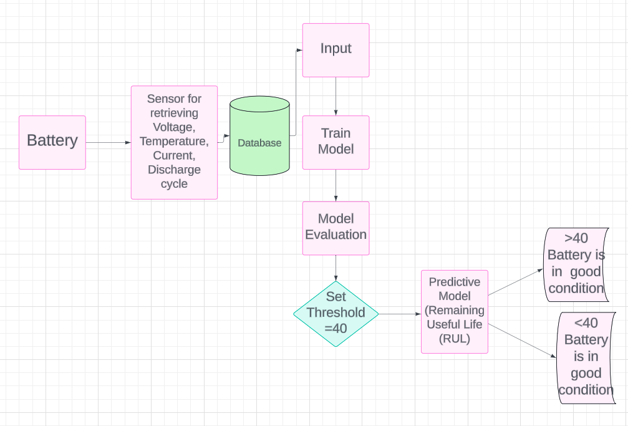
Proposed Architecture

Slide 19
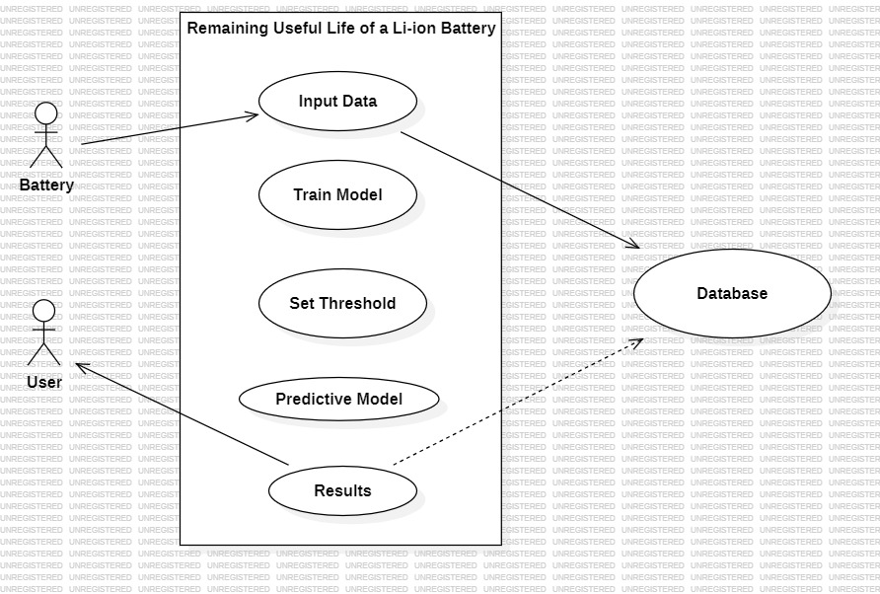
SYSTEM DESIGN
USE CASE DIAGRAM

Slide 20
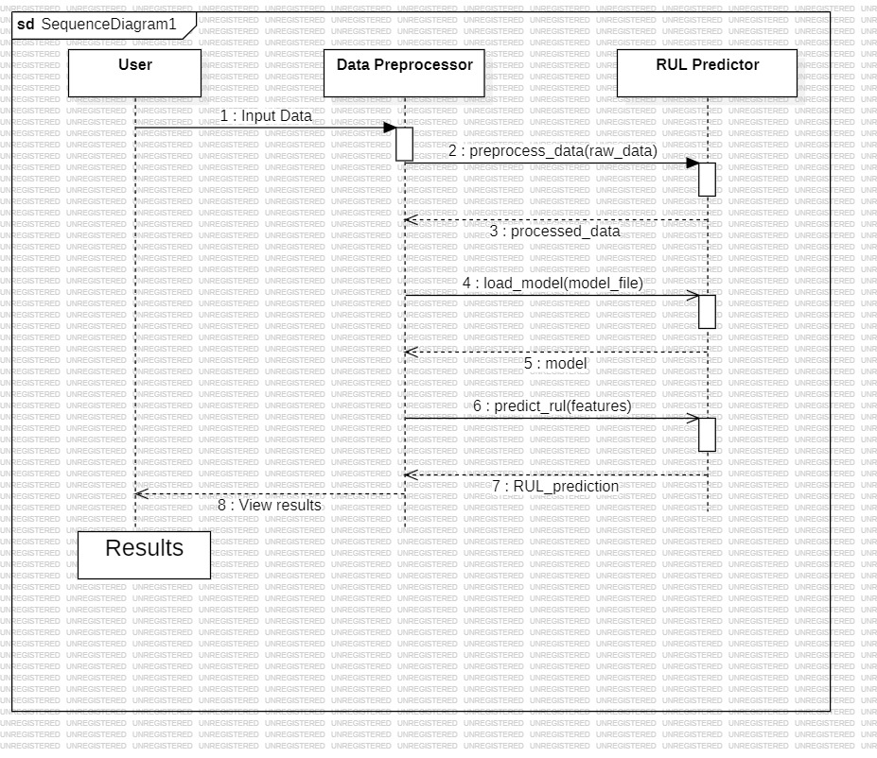
Sequence Diagram

Slide 21
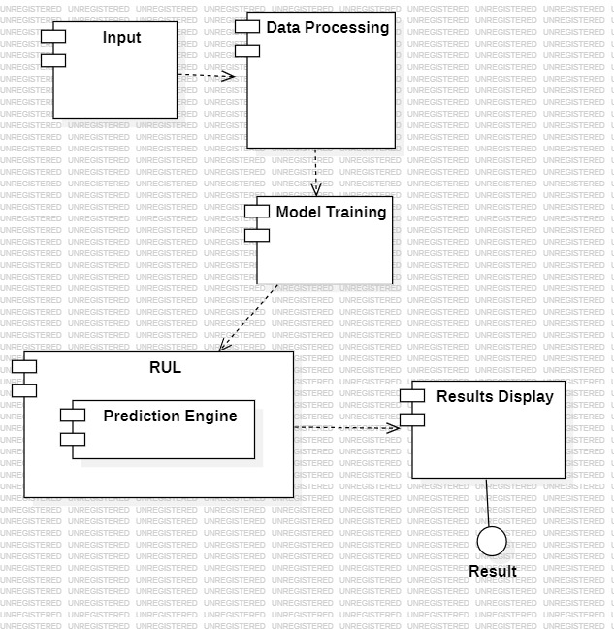
Component Diagram

Slide 22
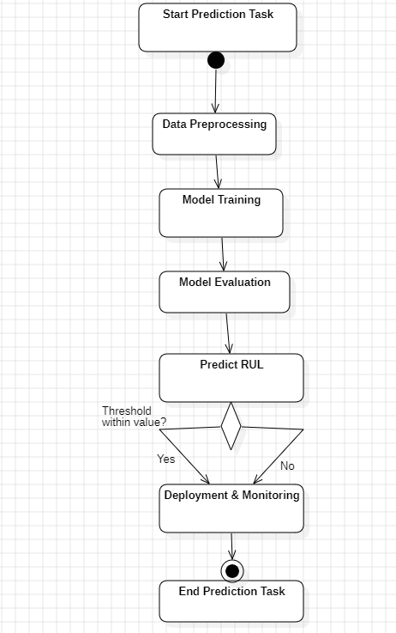
Activity diagram

Slide 23
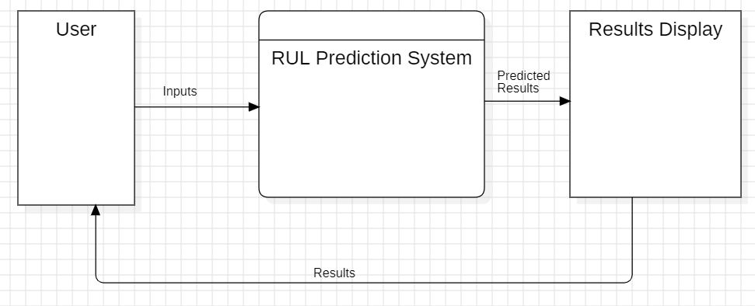
Data flow diagram (level 0)

Slide 24
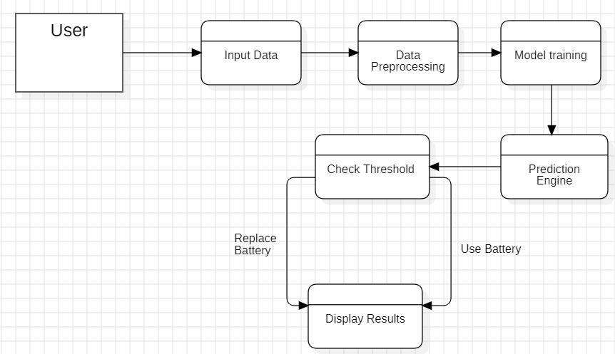
Data flow diagram (level 1)

Slide 25
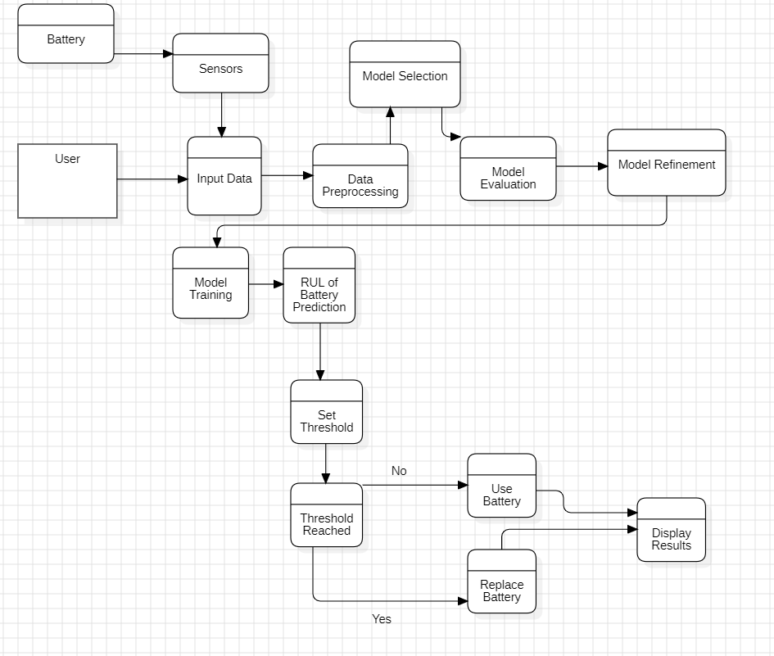
Data flow diagram (level 2)

Slide 26
System Environment
Python environment with required packages:
IDE – Jupyter notebook 7.1.3
OS – Windows 11
Necessary CSV files training_data.csv, testing_data.csv,
Packages | Versions
Matplotlib | 3.7.0
Pandas | 1.5.3
Scikit-learn | 1.2.1
Keras | 2.16

Slide 27
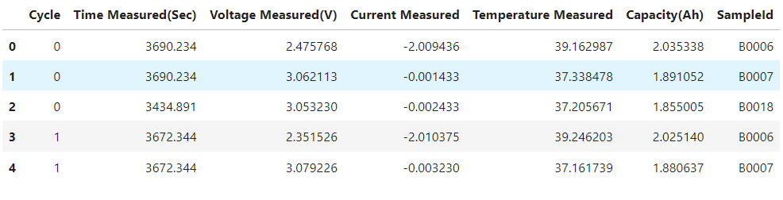
Dataset
Cycle: This column represents the cycle number for each measurement.
(Range: From 0 to 1 in this dataset).
Time Measured (Sec): This column represents the time in seconds when the measurement was taken.
Voltage Measured (V): This column represents the voltage measured during each cycle. (Indicates the voltage level measured during each cycle).
Current Measured: This column represents the current measured during each cycle. Indicates the current level measured during each cycle.
Temperature Measured: This column represents the temperature measured during each cycle.
Capacity (Ah): This column represents the capacity measured during each cycle.

Slide 28
Feature Extraction
Features:
Voltage
Temperature
Current
Discharge cycle

Slide 29
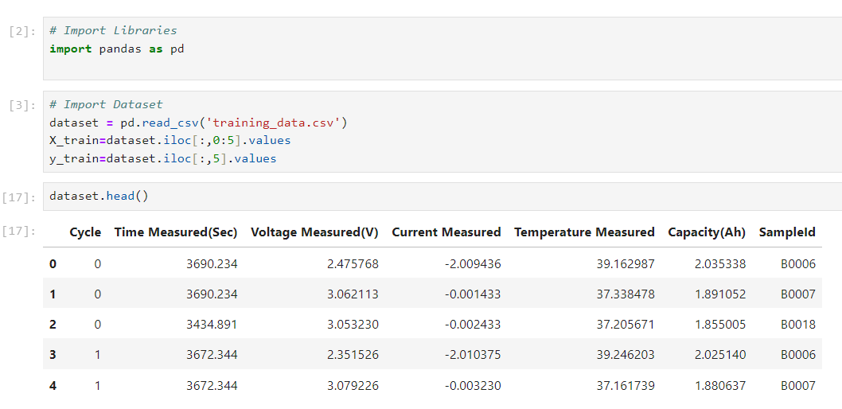
Code Implementation

Slide 30
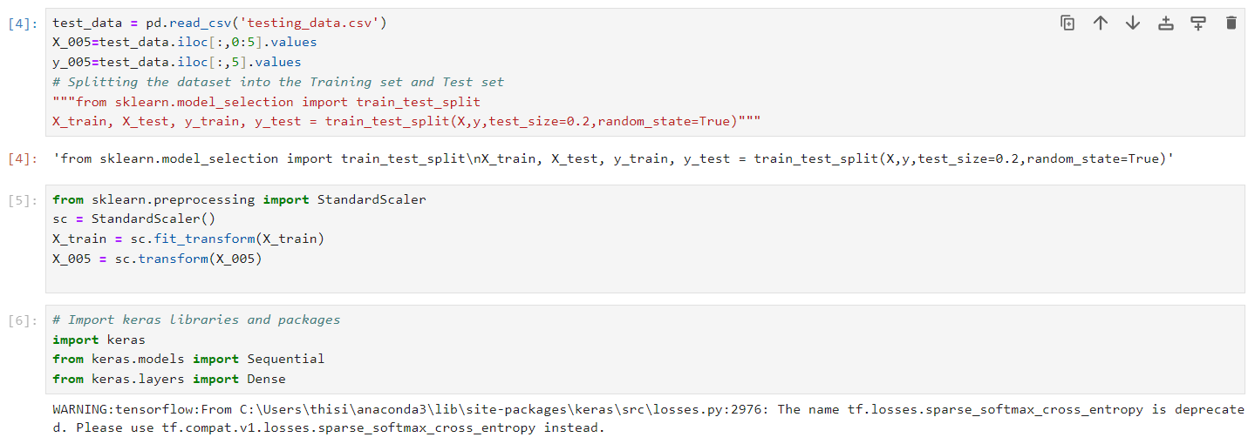
Code Implementation

Slide 31
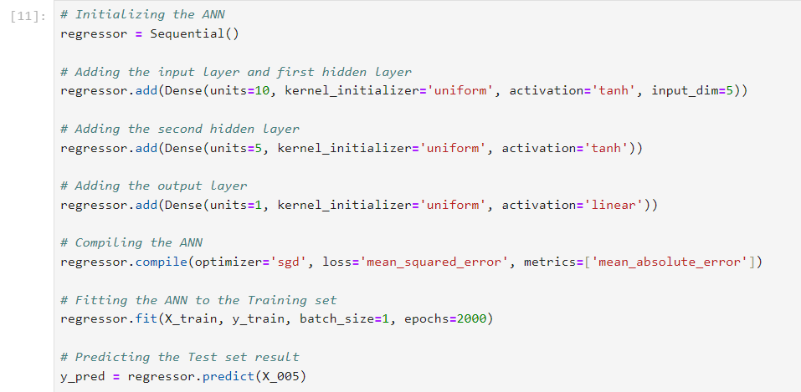
Code Implementation

Slide 32
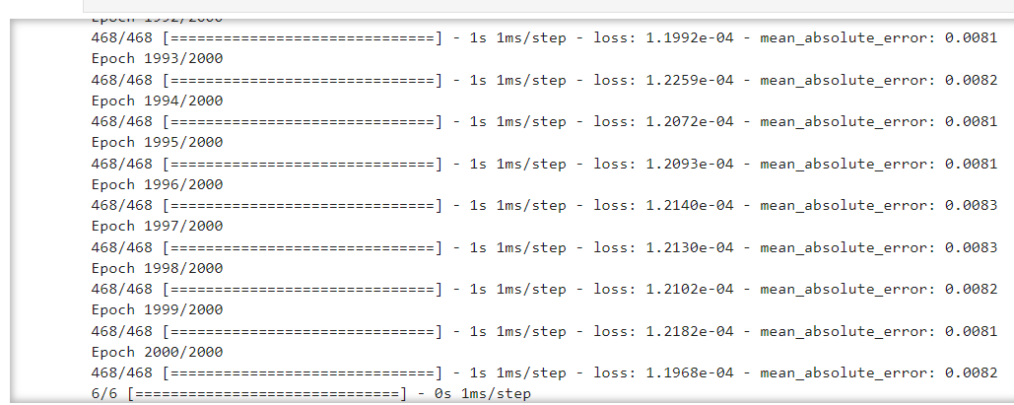
Code Implementation

Slide 33
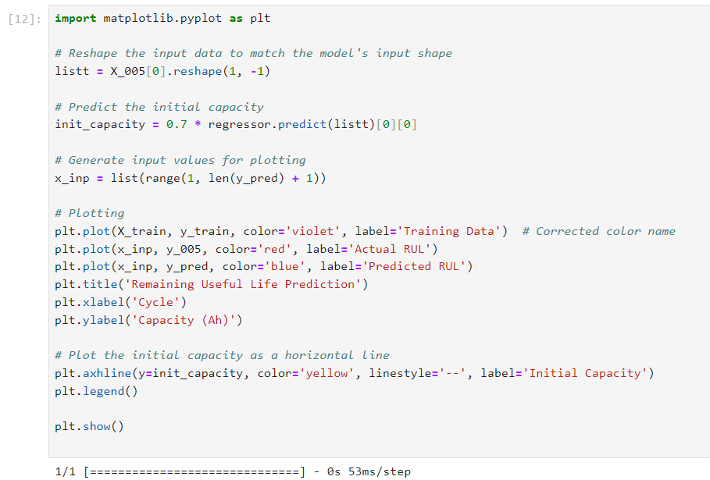
Code Implementation

Slide 34
Results
The value of R2 must tend towards 1.00 and the value of RMSE must tend toward 0 for good accuracy.
We considered all the parameters( i.e cycle number, voltage, current, temperature and time) as input to the neural network to calculate the capacity for a particular cycle then the accuracy of the model increases i.e.,
R2=0.9766
RMSE=0.0303

Slide 35
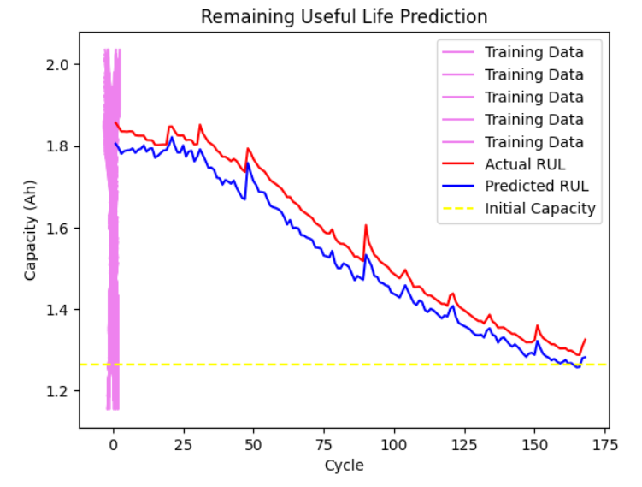
Results
The graph was plotted by training the NN by giving all the input parameters i.e
cycle number, voltage, current, temperature and time.
The capacity prediction gives a decent accuracy.. The accuracy of predicted capacity was measured using R square(R2) and root mean square error (RMSE) functions.
The capacity prediction gives a decent accuracy. As per the methodology implemented in the above mentioned research paper, capacity was predicted only using cycle number.
The accuracy of predicted capacity was measured using R square(R2) and root mean square error (RMSE) functions.
Fig 5: Prediction Graph of Battery showing initial capacity

Slide 36
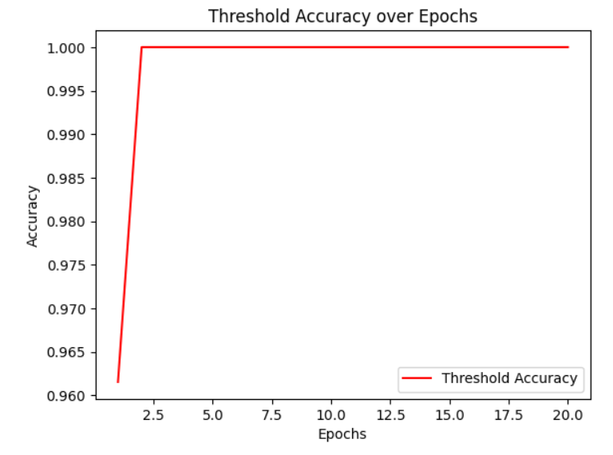
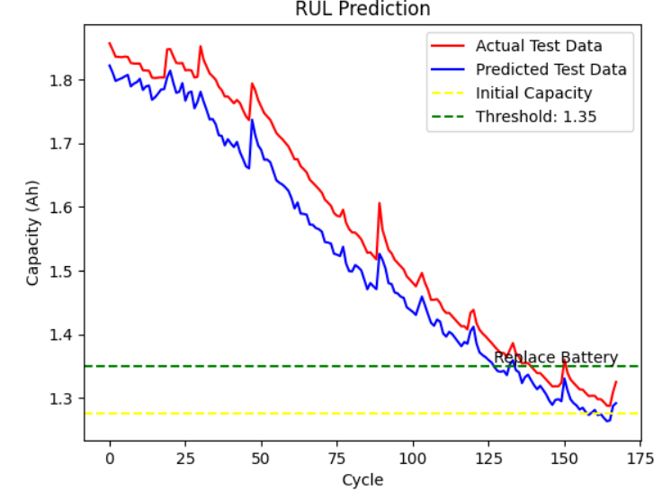
Results
This graph will plot the accuracy over epochs. Each point on the graph represents the accuracy achieved by the model on the validation set at the end of each epoch.
Fig shows the battery has reached the defined threshold value, since it reached the threshold value we need to replace the battery.
If the battery didn't reach threshold value then it shows to use the battery.
Fig 5: Epochs vs Accuracy
Fig 6: Cycle vs Capacity

Slide 37
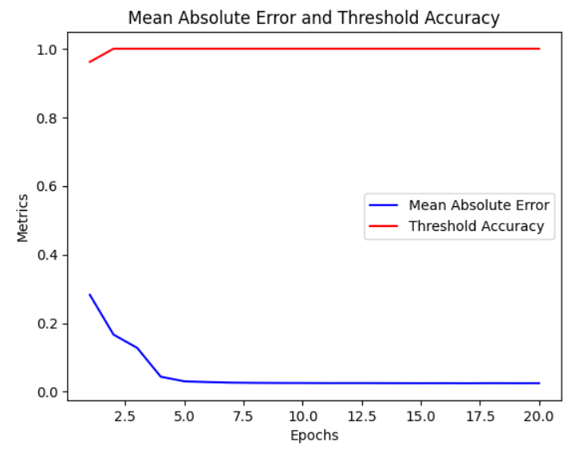
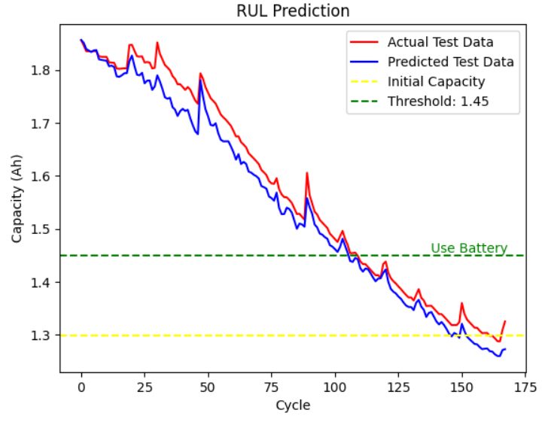
Results
Mean Absolute Error (MAE) and Mean Squared Error (MSE) are more commonly used for regression tasks.
If Threshold value is greater than set threshold then the graph is given below:
Fig 7: Epochs vs Metrics
Cycle vs Capcity(Ah)

Slide 38
References
[1] C. Hendricks, N. Williard, S. Mathew, and M. Pecht, ‘‘A failure modes,
mechanisms, and effects analysis (FMMEA) of lithium-ion batteries,’’
J. Power Sources, vol. 297, pp. 113–120, Nov. 2015.
[2] K. Javed, R. Gouriveau, and N. Zerhouni, ‘‘State of the art and taxonomy
of prognostics approaches, trends of prognostics applications and open
issues towards maturity at different technology readiness levels,’’ Mech.
Syst. Signal Process., vol. 94, pp. 214–236, Sep. 2017.
[3] Y. Zhang, R. Xiong, H. He, and M. Pecht, ‘‘Validation and verification
of a hybrid method for remaining useful life prediction of lithium-ion
batteries,’’ J. Cleaner Prod., vol. 212, pp. 240–249, Mar. 2019.
[4] M. H. Lipu et al., ‘‘A review of state of health and remaining useful life estimation methods for lithium-ion battery in electric vehicles: Challenges and recommendations,’’ J. Cleaner Prod., vol. 205, pp. 115–133, Dec. 2018.

Slide 39
References
[5] Y. Chang, H. Fang, and Y. Zhang, ‘‘A new hybrid method for the prediction of the remaining useful life of a lithium-ion battery,’’ Appl. Energy,
vol. 206, pp. 1564–1578, Nov. 2017.
[6] C. Hu, H. Ye, G. Jain, and C. Schmidt, ‘‘Remaining useful life assessment
of lithium-ion batteries in implantable medical devices,’’ J. Power Sources,
vol. 375, pp. 118–130, Jan. 2018.
[7] L. Liao and F. Köttig, ‘‘A hybrid framework combining data-driven and
model-based methods for system remaining useful life prediction,’’ Appl.
Soft Comput., vol. 44, pp. 191–19a9, Jul. 2016.
[8] Y. Zhou and M. Huang, ‘‘Lithium-ion batteries remaining useful life prediction based on a mixture of empirical mode decomposition and ARIMA
model,’’ Microelectron. Rel., vol. 65, pp. 265–273, Oct. 2016.

Slide 40
THANK YOU

